Slide 1
INTELLIGENT
HOSPITAL SYSTEM
Team:1
190330166_N.Manasa reddy
190330108_K.Sathvika
190330094_J.Keerthana

Slide 2
Contents
Introduction
Software Specifications
Modules
Database
conclusion

Slide 3
Introduction
Intelligent hospital system is a web server application which helps the user to get doctor appointment easily.
In this application our users can easy online appointment in the hospital.
The Details of Doctors and Hospital are visible to our uers but the personal details of our user cannot visible to staff members of our hospital

Slide 4
Software Specifications
ECLIPSE IDE
MYSQL DATABASE

Slide 5
Modules
This project contain six modules
Home module
Contact us module
Aboutus module
Register module
Service module
Doctors module

Slide 6
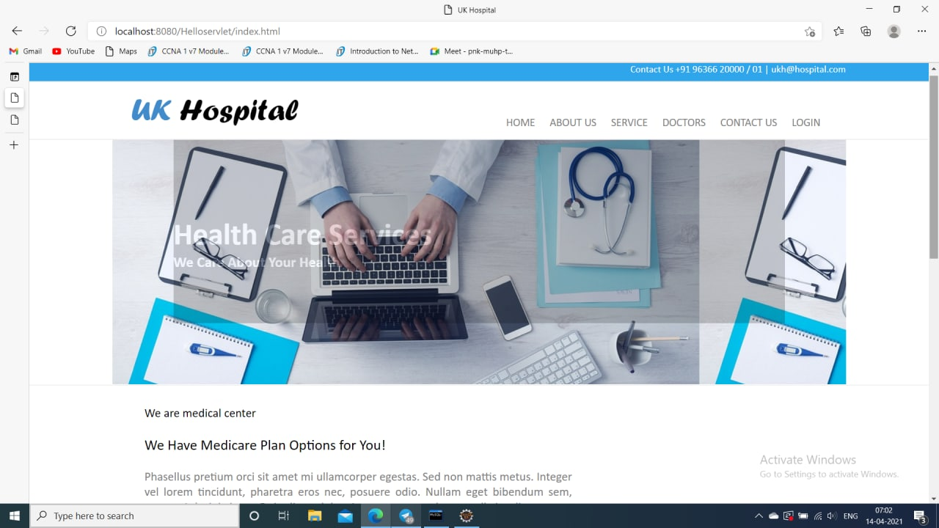
HOME MODULE

Slide 7
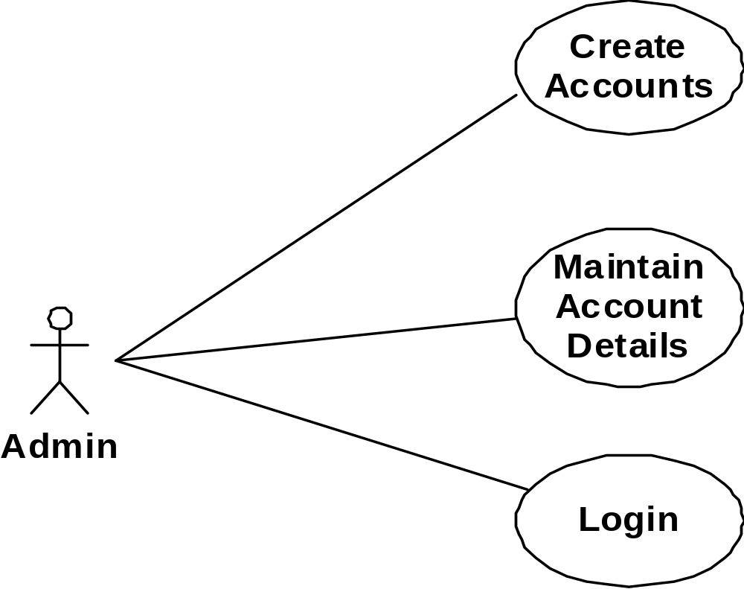
Admin Use Case

Slide 8
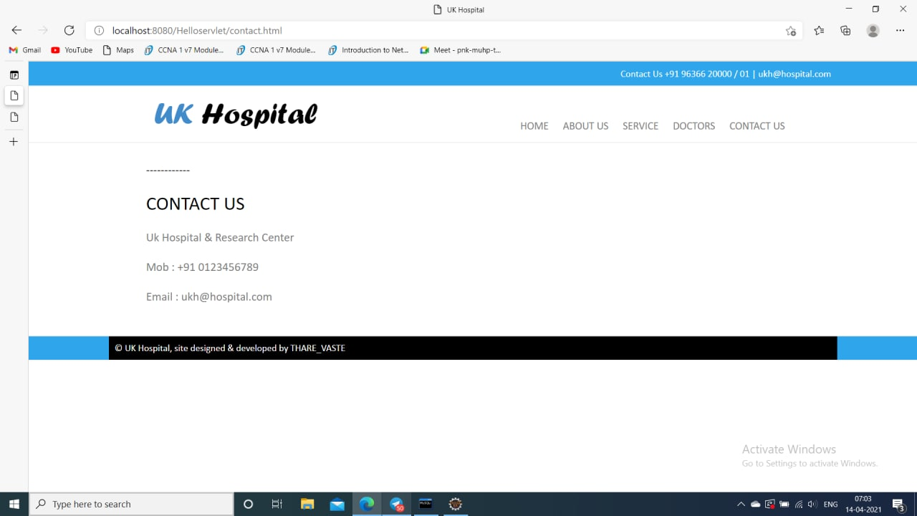
CONTACT MODULE

Slide 9
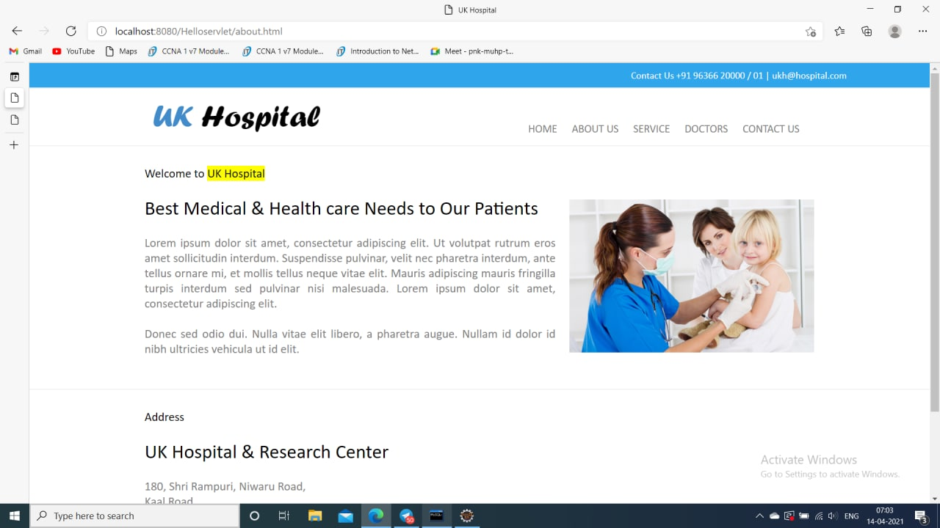
ABOUT US MODULE

Slide 10
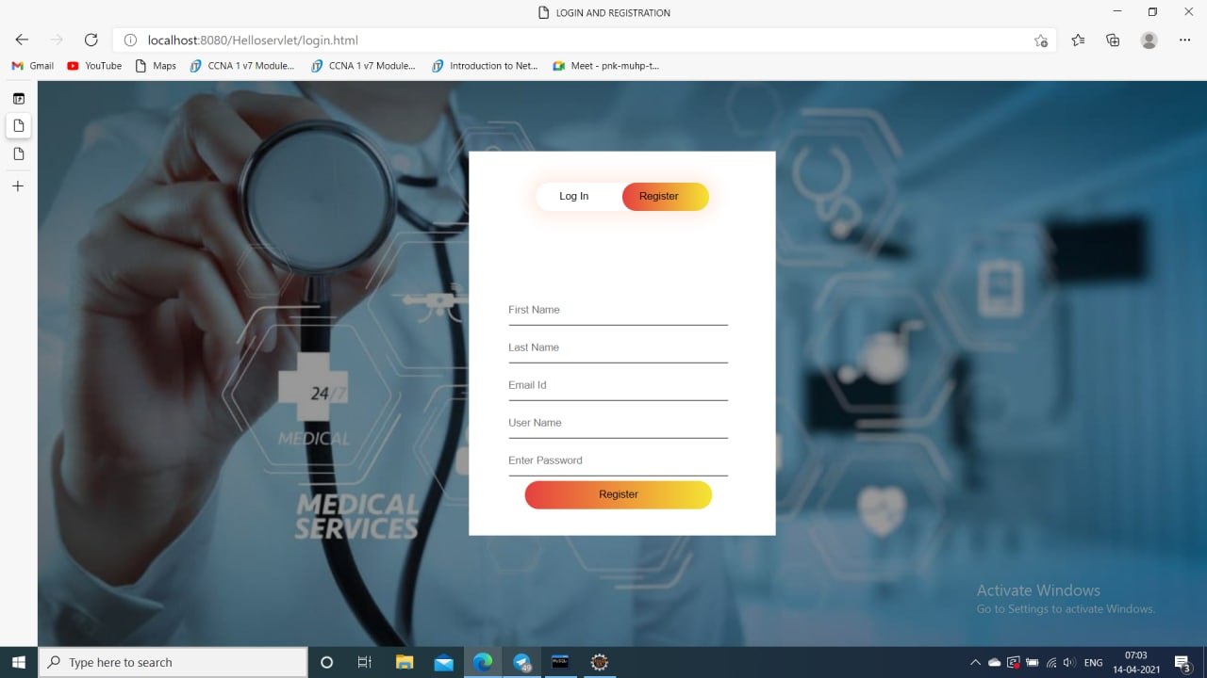
SIGNUP MODULE

Slide 11
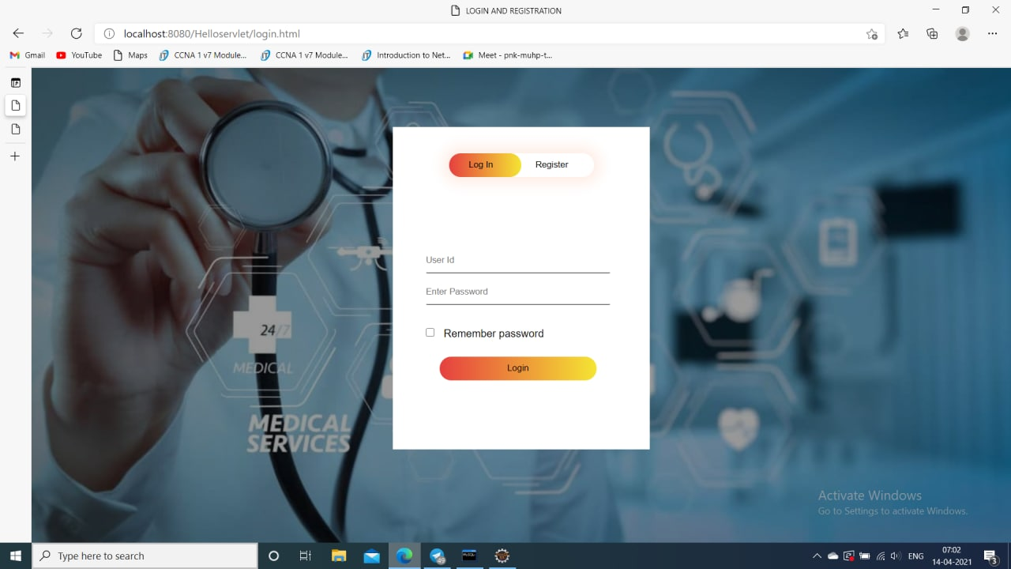
LOGIN MODULE

Slide 12
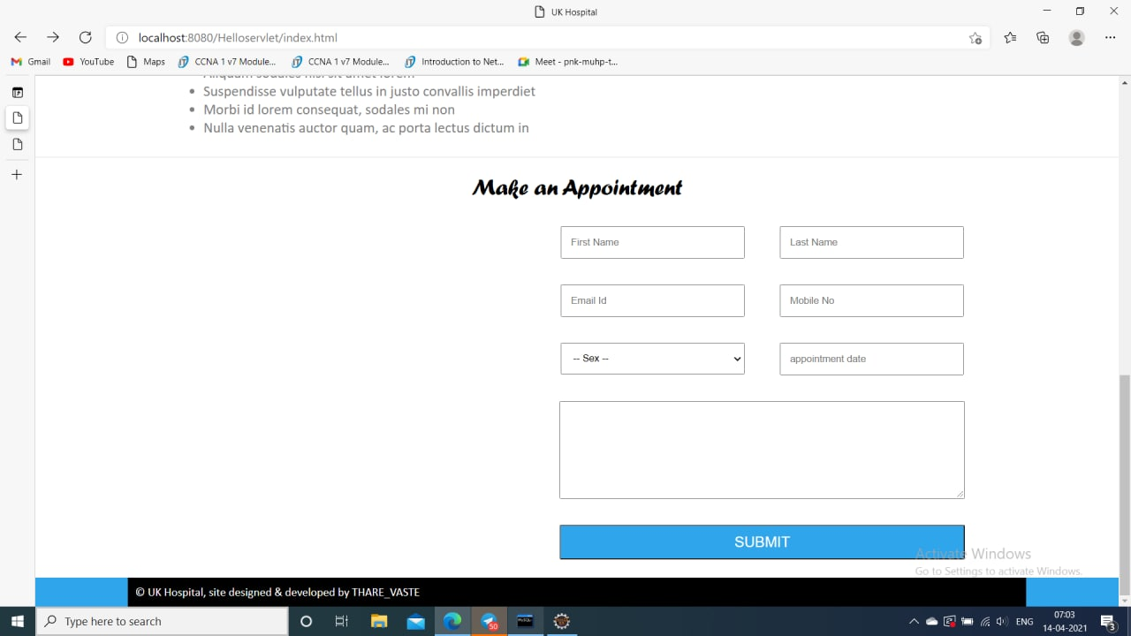
APPOINTMENT

Slide 13
Data Base
MYSQL used for database
By using this we can create the tables with the details of users
Tbl_Firstname
Tbl_Lastname
Tbl_EmailId
Tbl_Mobilenumber
Tbl_Gender
Tbl_Appointmentdate

Slide 14
DATABASE TABLE
Sno | Column | Datatype
1 | id | int
2 | Firstname | Varchar(30)
3 | Lastname | Varchar(30)
4 | Emailid | Varchar(30)
5 | Mobilenumber | bigint
6 | Gender | Varchar(30)
7 | Message | Varchar(200)

Slide 15
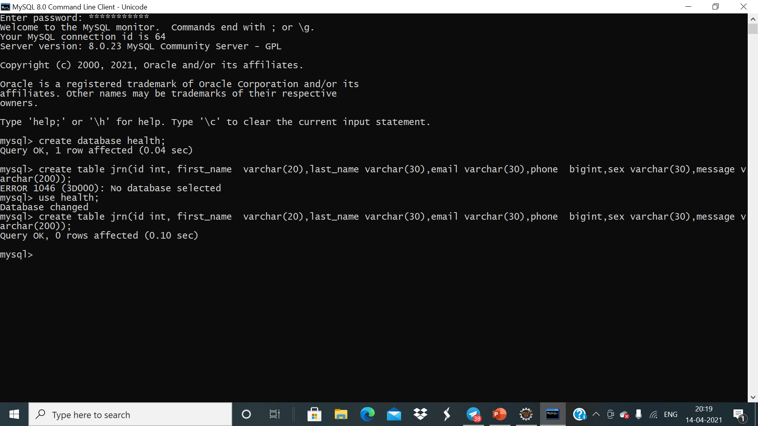

Slide 16
Conclusion
Intelligent Hospital Management System is a Web application and it is available for all users.
In this application our users can easy online appointment in the hospital.
The Details of Doctors and Hospital are visible to our uers but the personal details of our user cannot visible to staff members of our hospital.
And our Hospital Management System is 100% trustable.

Slide 17

Thank you'

